Slide 1
Anitoa Maverick Cloud Features
Features, use cases and system requirements

Slide 2
Topics
Basic features
User management
Assay information management
Results reporting
Support
Security
Use cases
System requirements
Security and support

Slide 3
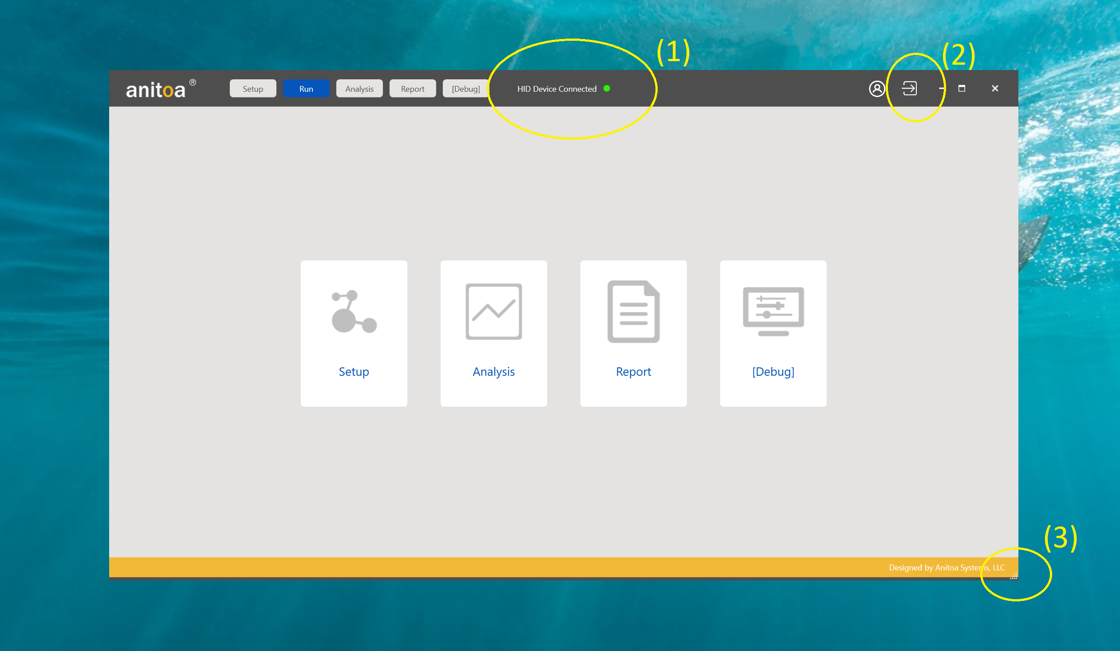
Basic features
Anitoa Maverick Software offers seamless and secure connectivity to cloud
Bi-direction communication allow sync data, files. E.g. Assay parameter files
Automatic save and store of experiment files for anywhere access.
Reports push to cloud, email notifications etc.

Slide 4
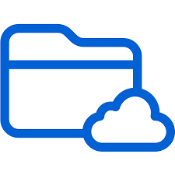
Use case: Sync data with cloud
e.g. Assay parameter file
Sync to local disk

Slide 5
Sync assay data with cloud
Vendor admin uploads assay parameters in cloud
Software automatically sync with cloud to pull latest data
Contains HTTP Client locally to access cloud
Local copy stored and used in case there is no internet connection
Data can be stored as structured data (e.g. json files) in a password protected area on vendor’s web site.

Slide 6
Use case 2: Store experiment data for access anywhere
(Lab)
(Home office)

Slide 7
Experiment data storage in cloud
It is useful to have a central repository of experiment data
Experiment data can be sync’d to cloud automatically
Integrate an FTP client in the Maverick Software
Option: Use IOT Telemetry from Microsoft Azure
With proper authorization, data can be accessed anywhere
Access from web server password-protected directory
Or direct Access with Maverick software

Slide 8
Use case 3: Send report to cloud and display in html table
CSV file
Viewed as HTML table in password protected web pages

Slide 9
Use case 4: Authenticate user through cloud
Login Page
User data base
Use services such as MS Azure Active B2C

Slide 10
Report push to cloud in secured area
Report can be pushed to cloud as CSV file securely
Report can be viewed as html table
Report access can be secured.
Password protected web pages.
Optionally send report as emails

Slide 11
Web server requirement
Can be as simple as Apache Web Server with .htaccess protected directories and web pages, ftp server for files.
Ot use the big three cloud services: AWS, Azure or Google Cloud.
Files can be stored in json, csv and other popular formats.

Slide 12
HIPAA compliance security rule
General Rules
The Security Rule requires covered entities to maintain reasonable and appropriate administrative, technical, and physical safeguards for protecting e-PHI. Specifically, covered entities must:
Ensure the confidentiality, integrity, and availability of all e-PHI they create, receive, maintain or transmit;
Identify and protect against reasonably anticipated threats to the security or integrity of the information;
Protect against reasonably anticipated, impermissible uses or disclosures; and
Ensure compliance by their workforce.⁴

